Slide 1
Analysis of Solar Power Cost over Time
05May2018
Mark Sausville
saus@ieee.org

Slide 2
The Problem
Produce a model that will allow prediction of the Fair Market Value cost of installing a solar electrical system so the customer can decide to install now or defer to enjoy more favorable pricing.

Slide 3
The CUSTOMEr
Jane Q. Public, homeowner
Direct purchaser of solar power
3 – 8 kwatts
Roof-mounted

Slide 4
The Data
https://openpv.nrel.gov/search
~1,000,000 rows, ~80 features
Two datasets
NREL – National Renewable Energy Laboratory
had many duplicates
LBNL – Lawrence Berkeley National Laboratory
had fields to id info source ➔ No duplicates

Slide 5
Growth of Home Solar Power

Slide 6
cost/watt over time

Slide 7
Residential vs Commercial

Slide 8
Residential vs Commercial Sizes
Table 3 Summary statistics for size (kw) in commercial and residential installations
 | count | mean | std | min | 50% | max
Com size(kw) | 15199 | 131.3 | 373.8 | 0.33 | 25.2 | 5999
res size(kw) | 745688 | 6.45 | 7.1 | 0.11 | 5.75 | 1989

Slide 9
Residential Size Distribution

Slide 10
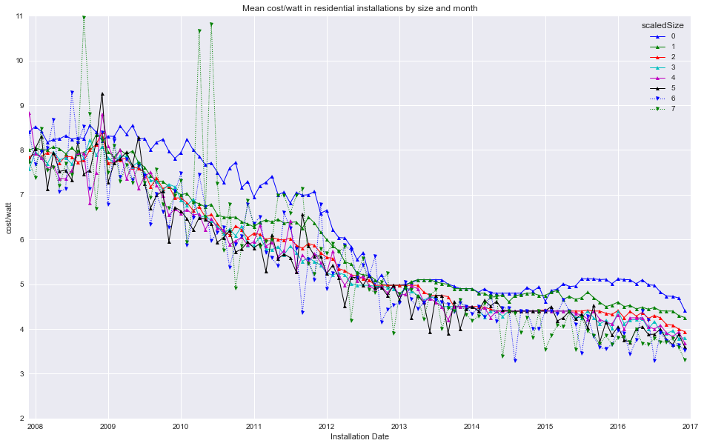
Cost vs size 1

Slide 11

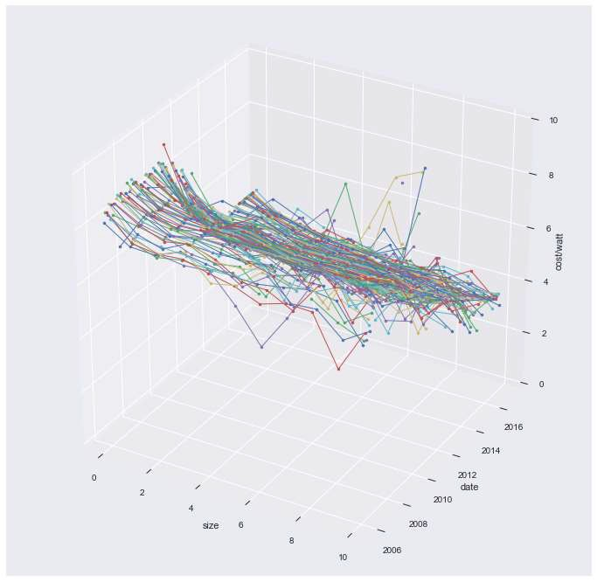
Cost vs size 2

Slide 12

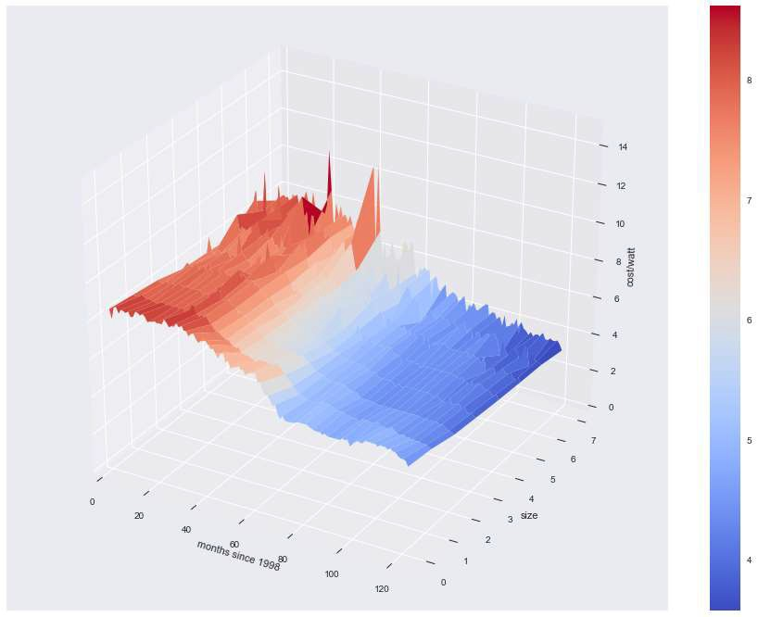
Cost vs size 3

Slide 13

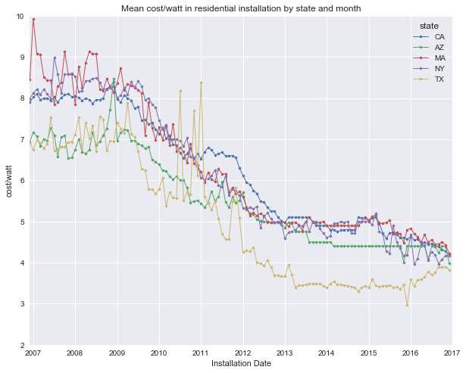
Does cost/watt vary by region?

Slide 14
Drivers of variation in cost/watt
The exploration show that the following features have a relationship with cost.
Time (strong)
Size (moderate)
Location (moderate)
We will use these features to model the cost.

Slide 15
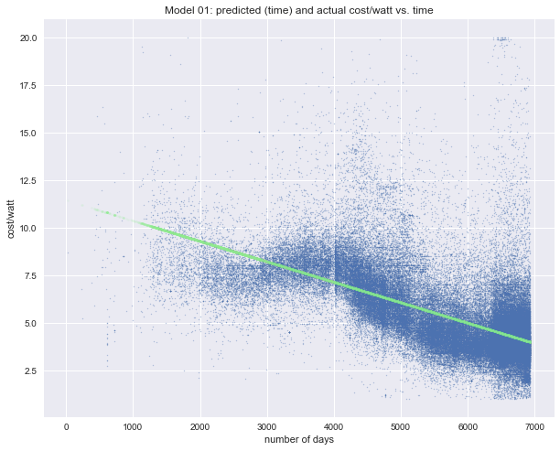
Model with Statistical/machine Learning
Noisy Data
Baseline Model
Add features
Transform features

Slide 16
Model 1: Linear (time)
R2: 0.404

Slide 17
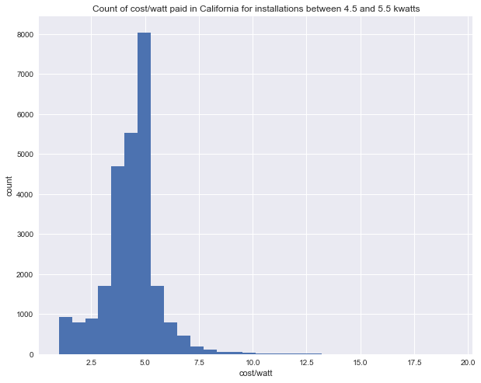
Interlude – Noisy data
California
2016
4.5-5.5 kw
26k installations
 | count | mean | std | 50% | max
cost_per_watt | 26107 | 4.41 | 1.33 | 4.50 | 19.30

Slide 18
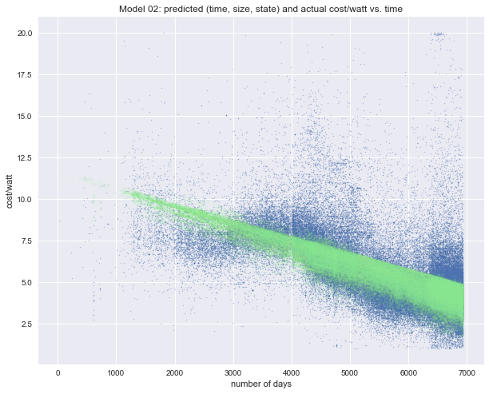
Model 2: lineaR (time, size, state)
R2: 0.4613

Slide 19
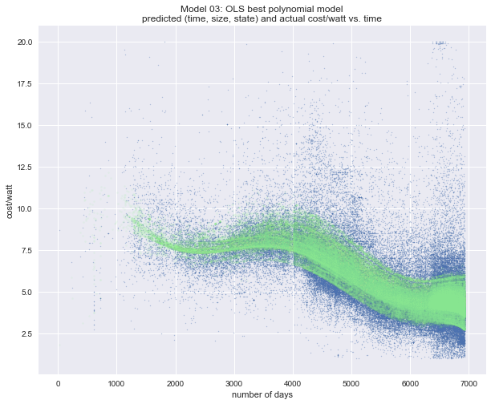
Model 3: Polynomial (time, size, state)
R2: 0.520
Degree: 14

Slide 20
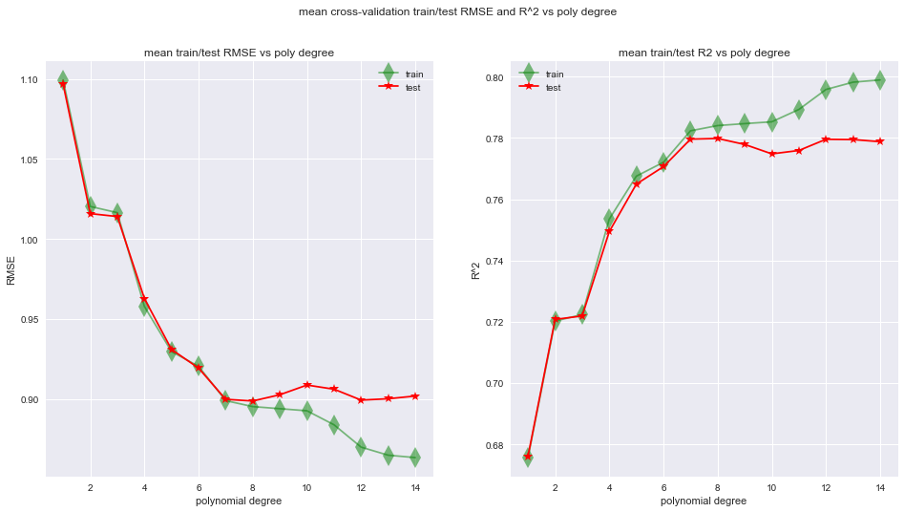
InterLude: hyper-parameter tuning
Approach:
Split into train and test
Grid-seach with cross-validation on training set.
Apply best parameters to the test set.

Slide 21
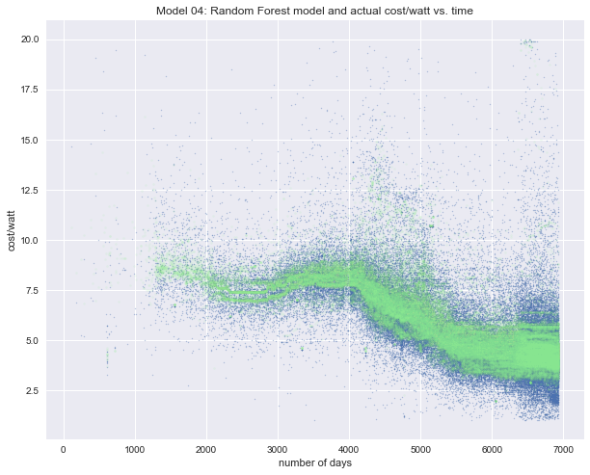
Model 4: Random Forest (time, size, state)
R2: 0.5993
Predicts noise!

Slide 22
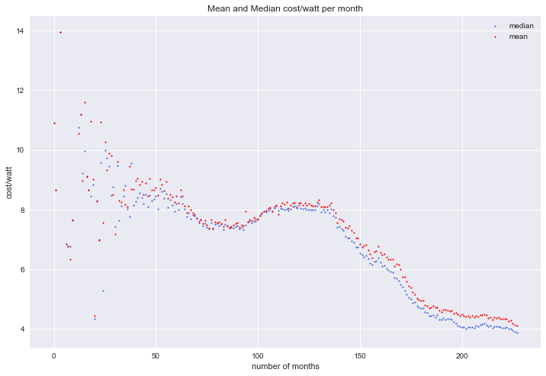
Interlude: Mean and Median
Mean rejects noise
Median rejects noise
Mean sensitive to outliers
Median is better proxy for Fair Market Value (FMV)

Slide 23
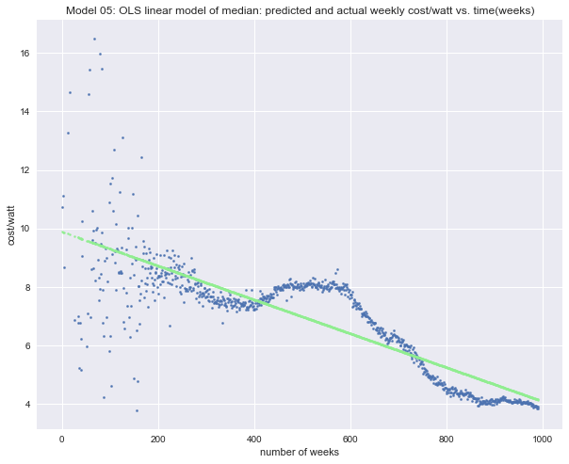
Model 5: lineaR (median(time))
R2: 0.715

Slide 24
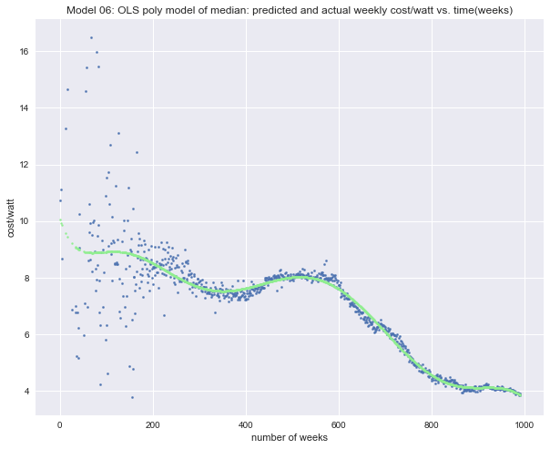
Model 6: Polynomial (time (median))
R2: 0.834

Slide 25
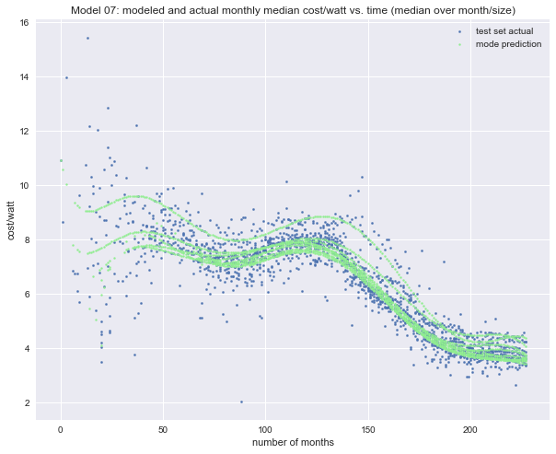
Model 7: Polynomial (time, size (median))
Time (months)
Degree

Slide 26
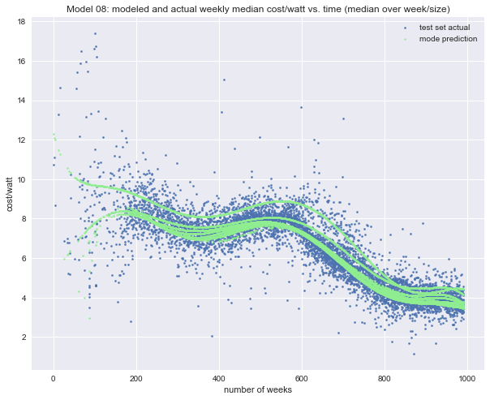
Model 8: Polynomial (time (median))
Time (weeks)
Degree
R^2

Slide 27
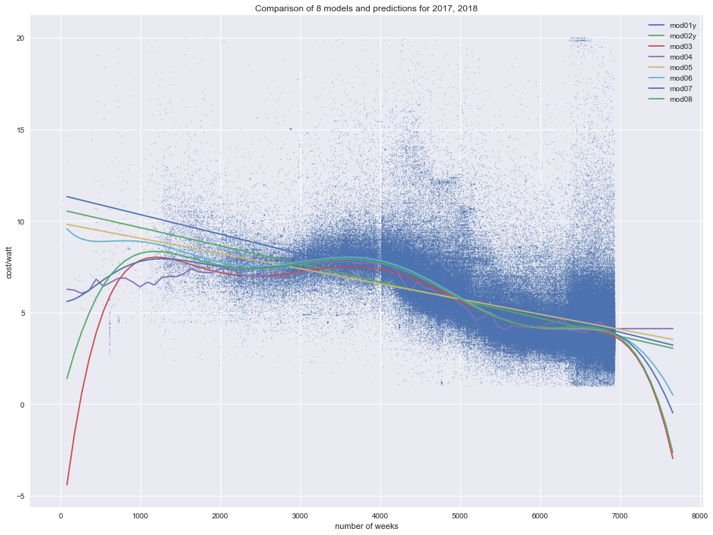
Predictions(I)
Extrapolate all models –reject outlying predictions.
Linear models
Polynomial models
Random Forest

Slide 28
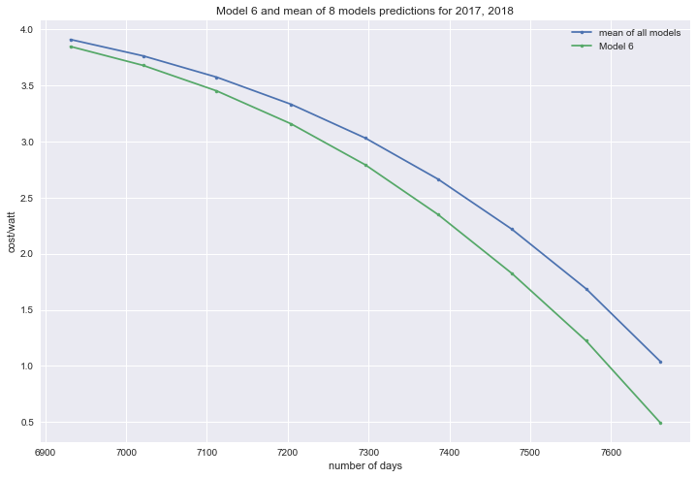
Predictions(ii)
2017/2018
8 quarters past EOD
Upper bound – mean()
Lower bound – model 6
 | 20161231 | 20170331 | 20170630 | 20170930 | 20171231 | 20180331 | 20180630 | 20180930 | 20181231
Mean prediction | 3.91 | 3.76 | 3.57 | 3.33 | 3.03 | 2.66 | 2.22 | 1.69 | 1.04
Model 6 Prediction | 3.85 | 3.68 | 3.45 | 3.16 | 2.79 | 2.35 | 1.83 | 1.22 | 0.49

Slide 29
Recommendations
“Will it be more cost-effective to install now, or will I save money by waiting a year or two?”
Get several competitive quotations for the solar installation
The data show that prices for similar solar installation vary dramatically (in some case by a factor of 10). A selection of vendors is likely to provide the best price. Getting a competitive price is probably more important than optimal timing of the purchase.
Given the shape of the predicted cost curve, it is reasonable to expect that median cost will drop by about $1.00/watt over 2017.
It is also reasonable to expect at least this rate of decline in 2018 and there are grounds to believe that the rate of price decline will accelerate in 2018. It would be prudent to revisit this analysis incorporating more data as it becomes available.
Given these predictions the customer can weigh the current cost of installation and the expected price decrease and make an informed decision.

Slide 30
Future Work
Validate with 2017 data, when it becomes available.
Experiment with other feature transformations (logistic function).
Apply time-series methods.
Measure other regressors.

